Slide 1

User Privacy & Security in Internet: A Concern for Bangladesh
Asif Hossen Nipun Roll: ASH1701052M
Under The Supervision of
Md. Javed Hossain
Associate Professor
Department of CSTE, NSTU
Dept. of Computer science and Telecommunication Engineering
Noakhali Science and Technology University
April,2021

Slide 2
Introduction
Social engineering is an attack vector that primarily focuses on human interaction and typically includes persuading individuals to violate traditional security policies and best practices in order to gain unauthorized access to systems, networks, or physical locations, or for financial gain.
Big companies like Facebook, Google, Microsoft are giving prime concern to the user security and privacy. But sometimes users are losing their data security for their own mistakes and by falling in trap created by bad guys of internet. The mass people of the country are not adaptive with the new concept of security measure.

Slide 3
Motivation
We have experienced many Bangladeshi internet users who uses their name, birth date, phone number or part of phone number as their password. They also use it in so many aspects. This is a potential risk of being attacked by Social Engineering hacking method.

Slide 4
Objectives
To analyze the vulnerability of the users of Bangladesh in using internet password.
To determine the primary target of social engineering attack.
To raise consciousness about being safe in cyber world.

Slide 5
Related Works
Security aspects in using E-banking
31% respondents of the entitled research said e-banking security is not sufficient in Bangladesh. Out of the total respondents 11.5% do not know about the security status of e-banking in Bangladesh. Among the respondents 31.7% uses some digits as their password.13.3% uses only name or letter, 18.3% uses some digits and some letters and 28.33% respondents don’t maintain e-banking accounts[1].

Slide 6
Related Works
Why Do People Adopt, or Reject, Smartphone Password Managers
It states that very low amount of people can use password managers to create and store password. From them, a few users had chosen secure password manager.
The study also provides that only 33 percent of iPhone users had used Touch ID .
They are not in a good command with creating several password for different sites[2]

Slide 7
Related Works
Digital Privacy Challenges with Shared Mobile Phone Use in Bangladesh
This paper presents a qualitative study with 72 participants that analyzes how families in Bangladesh currently share mobile phones, their usage patterns, and the tensions and challenges that arise as individuals seek to protect the privacy of their personal data. We show how people share devices out of economic need, but also because sharing is a social and cultural practice that is deeply embedded in Bangladeshi society[3].

Slide 8
Research Methodology
Triangulation Strategy
Qualitative
Information
Quantitative Information
Data Collection & Analysis
Data Collection &
Analysis
Results Compared, Integrated & Interpreted

Slide 9
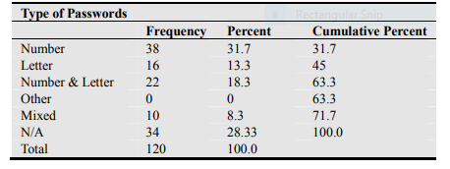
Research Methodology
Secondary Data Overview

Slide 10
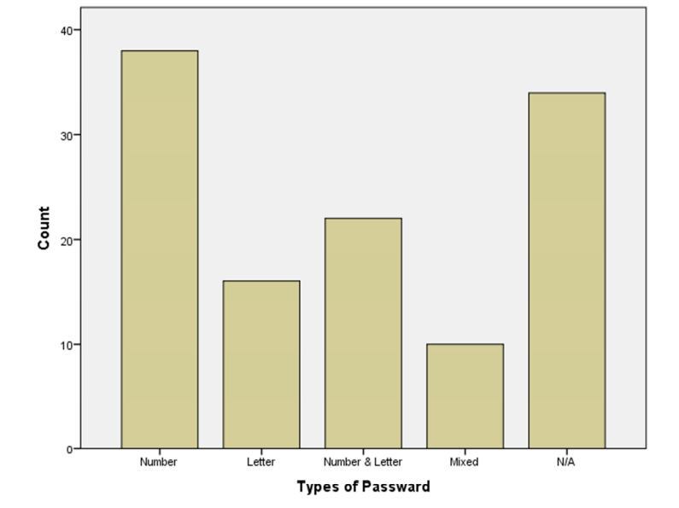
Research Methodology

Slide 11
Primary Data Collection
We have done online survey among users of various classes and standards for attaining the problems they faced about privacy topic under their experience on internet.
Noakhali Science & Technology University
Barisal University
Premier University Chattogram
Via
Google Forms
The survey consist of five to six questions with having multiple choice answering system. Users were able to give more than one answer per question in multiple answer aspects. [4]

Slide 12
Resources
Google Forms
Google spreadsheet
Microsoft Excel
Jupyter Notebook for live code, educational and computational output and visualization
Python codes for data mining, reshaping and analyzing
Microsoft Word for Documentation and overview

Slide 13
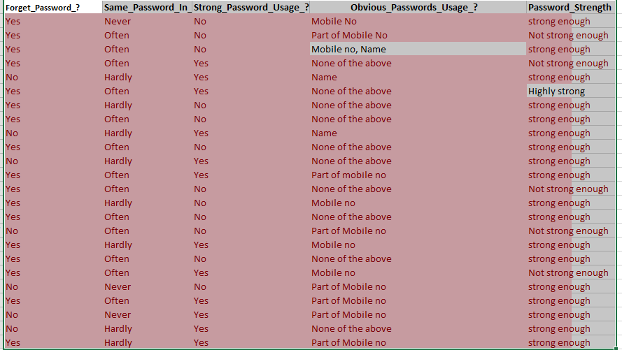
Survey data Portion Snapshot

Slide 14
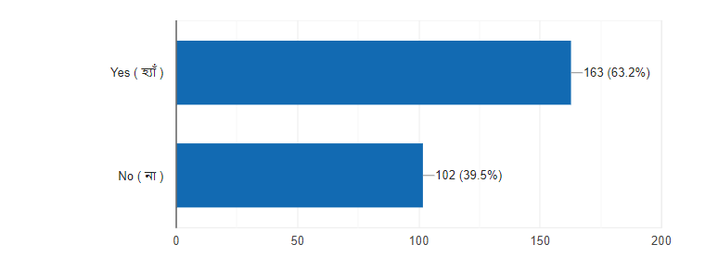
Forgetting Password Percentage

Slide 16
Survey Data Analysis
Area of Survey | University | Miscellaneous
Part of Mobile Number | 90 ( 34.9 % ) | 12 (36.4%)
Mobile Number | 41 (15.9 %) | 0 ( 0% )
Name | 113 (43.8 %) | 9 (27.3 %)
Birth Date | 42 (16.3%) | 3 (9.1 %)
None Of These Above | 82 (31.8 %) | 12 (36.4%)

Slide 18
Analysis
The table of data shows that above 50 percent of the university participant uses or used a password containing mobile number or part of mobile number. Password containing Name of the users was 44 percent. 16 percent stated that they had used their birth date as password.
31 percent users reported that they never used these sorts of passwords. On the other hand , outside of the university participant states that 36 percent of the internet users use part of their phone number as passwords. 27 percent of them used Name as Passcode and 36 percent never use any of these.

Slide 19
Output
People are very much familiar with using phone number, substring of phone number, birth date, name etc as their password. But the information briefly explain that almost half or 50 percent of people use only phone number or part of phone number as their password. As the users uses the same password in several sites, they uses this easily guessable and vulnerable password strategy in social networking sites, financial security and other aspects of internet uses[5].

Slide 20
Output
The part of the phone no is nothing but the last six digit of the phone number as we are experiencing. And it is more preferable by the users of Bangladesh to use last six digit of their phone no as their password. If people uses these sorts of passwords in several sites then it will be a big issue of user vulnerability which makes it easier for the attackers to exploit the privacy of the Bangladeshi internet users.
0 1 8 2 5 | X X X X X X

Slide 21
Invention in our study
We have detected that phone number or substring of phone number is used more than 50% of the users ongoing or used previously.
Specially Last 6 Digit of phone number is widely used.
We have a strong belief and some probabilistic results that ensures that Pattern based last 6 digit of phone number could be used as password more widely than only the last 6 digit.

Slide 22
Conclusion
From our experience in this research, we have deeply acknowledged that users of internet in Bangladesh are familiarly occupied with using digit based password. Specially, Phone number is the high in using probability. Our new invention is that they uses the last 6 digit of phone number as their password. This is a huge risk for our country internet users for future as attackers may attack them by knowing vulnerability of the users.

Slide 23
Future work
Our research have some limitations as our data mainly collected from the young users . Future work should be done under a large diversity of users to get more accurate results. Also pattern based password using survey can be done under this topic as people are very familiar with pattern based password using. If the part of phone number is a pattern then users will use this as password that is highly possible.

Slide 24
References
Mohammad Shamsus Sadekin, Md. Abdul Hannan Shaikh. Security of E-Banking in Bangladesh. Journal of Finance and Accounting. Vol. 4, No. 1, 2016, pp. 1-8. doi: 10.11648/j.jfa.20160401.11
Alkaldi, Nora, and Karen Renaud. "Why do people adopt, or reject, smartphone password managers?." (2016).
Syed Ishtiaque Ahmed, Md. Romael Haque, Jay Chen, Nicola Dell, “Digital Privacy Challenges with Shared Mobile Phone Use in Bangladesh”, Proceedings of the ACM on Human-Computer Interaction, Volume : 1, Issue No : CSCW, Article No : 17, December 2017, https://dl.acm.org/doi/10.1145/3134652
All dataset Link : https://drive.google.com/drive/folders/1hEy3tq2xZOYDyBJ9vsr-hljJeu0z7HWZ?usp=sharing

Slide 25
Thank You
Very Much

